Slide 1
Microsoft Power Automate

Slide 2












Jenkins NS
Modern Workplace Solution Architect | Consultant
15+ Years of experience
Microsoft Teams, Power Platform and SPFx Specialist
International Speaker | Blogger | Trainer
SPS Bangalore Organizer
aOS Ambassador
jenkinsns@gmail.com
in/jenkinsns
@jenkinsns
http://www.jenkinsblogs.com
jenkinsns
https://www.facebook.com/spfxinfo/
https://www.facebook.com/msteamsinfo

Slide 3
Introduction to Power Platform

Slide 4

Notes:
It starts with how they get the most out of their business data
Data is everywhere – generated at every step of our lives
90% of world’s data generated in last 3 years alone
Everything we do, everything our customers do, everything competitors do generates some kind of data
T: In the old world, that data lived in siloes

Slide 5
Low Code Evolution

Slide 6

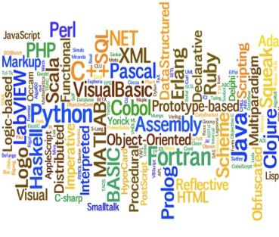


The evolution of how people buy applications
Custom Software
Packaged Software
Low-code Development
What development language do you use?
How feature rich is your software?
How agile and extensible is your platform?
ERP
CRM
HRM
ERP
CRM
HRM
Middle
-ware
MRP
Middle
-ware
PRM
MRP
PRM
MRP
OPS
LOG.
…
OPS
PRM
…

Slide 7
Benefits of low-code development platforms
Environment used to create web or mobile applications easily by mostly configurations, drop-and drops.
LOW-CODE
DEVELOPMENT PLATFORMS
Higher rate of success
Loved by both Business & IT
Breeds Innovations
Days to Weeks
Success Rate
Time to Live
Business Relevance
Innovative Culture
Traditional computer programming, writing lines of codes from scratch.
Failed projects are common
Lagging IT & constant tension with business
TRADITIONAL
DEVELOPMENT
Months to Years
Curbs Innovation

Slide 8






Who buys Power Platform?
“We need faster growth.”
“I need my teams to do a lot more with a lot less.”
CXOs
GROWTH
CFOs
EFFICACY
“We are shackled by our legacy tech. & it’s too risky to migrate!”
“Most of my employees are not desk-bound nor IT-savvy”
CIOs
INNOVATION
BDMs
ACCESSIBILITY
“So many disparate businesses with M&A, I don’t know how to start to integrate.”
“Too many manual or redundant processes because company’s IT or systems don’t work for us.”
COOs
CONSOLIDATION
Users
CITIZEN PAINS

Slide 9
Power Platform loved by businesses in all segments
Enterprise
Corporate
Midmarket
Small
Innovation platform – justify once, unlimited innovations forever
Easy first step to your digital transformation journey
Breeds unique & inclusive IT and Business innovation culture with citizen development philosophy
One Microsoft Story – MS understands business of Platforms
Company-wide digitized with easy-to-use mobile/IoT enabled applications even for frontline workers
Significantly lowered cost of automation, digitization and innovation
Fuss-less continuous innovations with citizen development capabilities
Easy to create, easy to retire, easy to change

Slide 10



Microsoft Power Platform
The low-code platform that spans Office 365, Azure, Dynamics 365, and standalone applications
Innovation anywhere. Unlocks value everywhere.
Power BI
Business analytics
Power Apps
Application development
Power Automate
Process automation
Power Virtual Agents
Intelligent virtual agents
Data connectors
Portals
AI Builder
Common Data Service

Slide 11




Who here has a Microsoft 365 background?
SharePoint, Teams, Exchange…
Microsoft 365
Analyze
Act
Automate
Data connectors
Power BI
Business analytics
Power Apps
Low-code/no-code application development
Power Automate
Workflow automation
Standalone apps
Common Data
Service
AI Builder

Slide 12
What about a Dynamics 365 background?
Sales, Service, Talent…
Microsoft 365
Dynamics 365
Analyze
Act
Automate
Data connectors
Power BI
Business analytics
Power Apps
Low-code/no-code application development
Power Automate
Workflow automation
Standalone apps
Common Data
Service
AI Builder

Slide 13
Last, but not least, what about Azure?
Azure SQL, Azure Functions…
Microsoft 365
Dynamics 365
Microsoft Azure
Analyze
Act
Automate
Data connectors
Power BI
Business analytics
Power Apps
Low-code/no-code application development
Power Automate
Workflow automation
Standalone apps
Common Data
Service
AI Builder

Slide 14
Why Power Platform?
Time
Resources
Cost
Data
Maintenance

Slide 15
Power Platform Components
Power BI
Business analytics
Power Apps
Application development
Power Automate
Process automation
Power Virtual Agents
Intelligent virtual agents

Slide 16




Let’s talk about data
Analyze
Power BI
Know
Act
Automate
Power Apps
Automate
AI Builder
Learn

Slide 17
Let’s talk about data
Analyze
Power BI
Know
Act
Automate
Power Apps
Automate
Connectors
AI Builder
Learn

Slide 18

Let’s talk about data
Analyze
Power BI
Know
Act
Automate
Power Apps
Automate
CDS
AI Builder
Learn

Slide 19

Two Types of Data. . .
External
Internal

Slide 20
Two Types of Data. . .
Connectors
Common Data Service

Slide 21
Oh, the apps you can build. . .
Client | Connectors | Common Data Service
Power Apps (Canvas) | Yes | Yes
Power Apps (Model) | No | Yes
Power Portals | No | Yes
Flows | Yes | Yes
AI Builder | No | Yes
PowerBI | Yes | Yes

Slide 22
Why external data (Connectors)?
It’s easy
It’s home

Slide 23

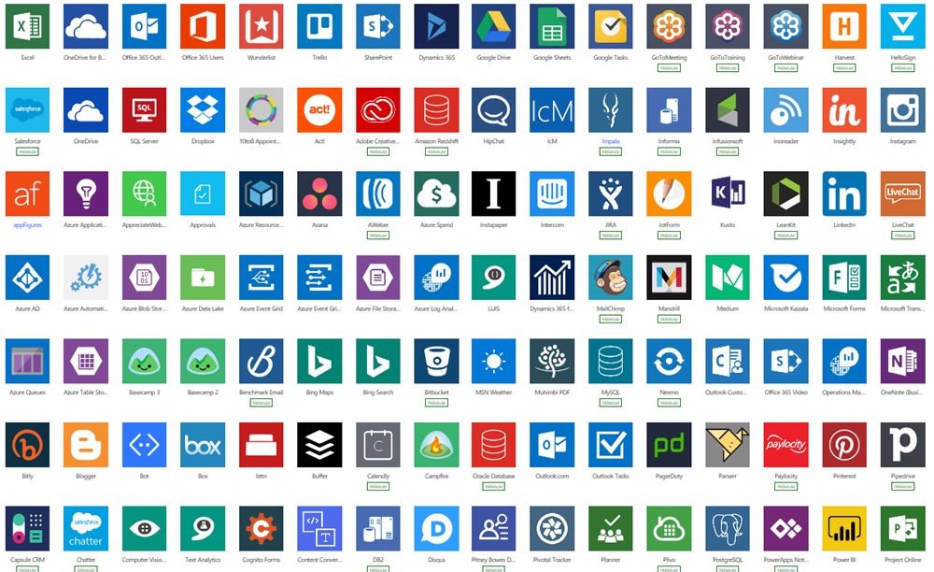
Why external data (Connectors)?
Built-in connectivity to 300+ cloud services, content services, databases, APIs, etc.
Seamless hybrid connectivity to on-premises systems via the on-premises data gateway.
Develop and register custom connectors as a building block for citizen developers.
Connect data silos by using multiple data sources in a single application.

Slide 24
Why internal data (Common Data Service)?
It’s smart
It scales
It’s secure

Slide 25
What is the Common Data Service?
The Common Data Service easily structures
a variety of data and business logic to support
interconnected applications and processes
in a secure and compliant manner

Slide 26

Module 1
What is Microsoft Flow
Microsoft Flow Basics
Types of Flows
Flow Components
Differences between Flows and Workflows
The benefits of automation
How to get to Flow
Setup Environment

Slide 27
Introduction

Slide 28

Where we come from
Every organization who has implemented SharePoint must have used workflows to automate their business process. Microsoft provides various options for creating workflows, here we will check SharePoint Designer Workflow vs Microsoft Flow.
There are different ways to create workflows in SharePoint like:
Using Out of box workflow
Using SharePoint designer workflow 2013
Using Visual Studio
Using 3rd party tool
Windows Timer Jobs / Schedulers
And Microsoft has introduced Microsoft Flow in Office 365

Slide 29
Where we come from
Microsoft has not released any new versions of the SharePoint designer after SharePoint designer 2013, no new designer for SharePoint 2016, SharePoint 2019 or SharePoint Online. In workflow architecture also, there are not many changes for any version. Rather Microsoft has invested heavily on Microsoft Flow to provide an alternative to designer workflows (this is not officially announced by Microsoft, but has been assumed based on the functionality provided in Microsoft flow).
Microsoft Flow is nothing but a service which helps to create an automated workflow for your business needs. This Microsoft Flow is a replacement to SharePoint Designer. That means, Instead of Designer Workflow, Now we can simply create a Microsoft Flow and we can use it as per our requirement. Microsoft Flow is basically used to allows users to create cross-application workflows..

Slide 30

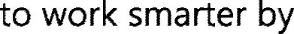



What is Power Automate?

Slide 31
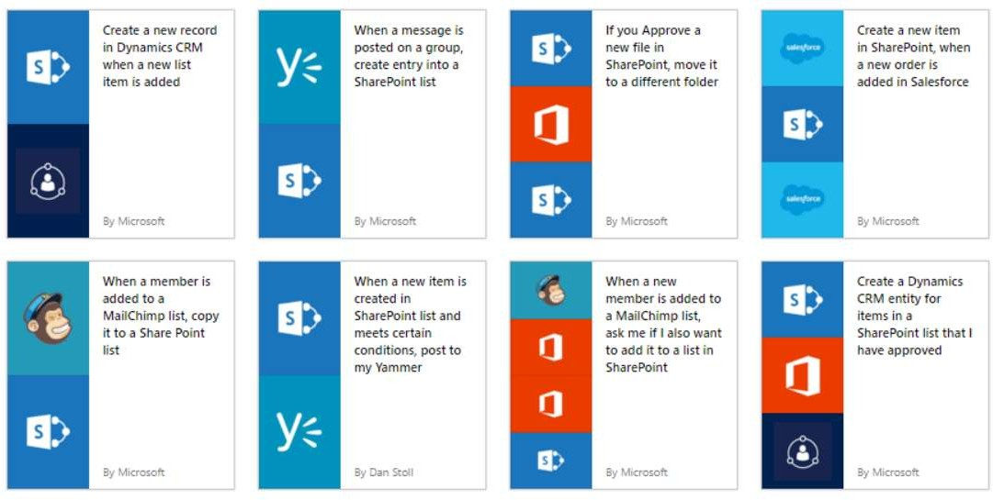
GET STARTED
https://flow.microsoft.com
Source: Microsoft

Slide 32
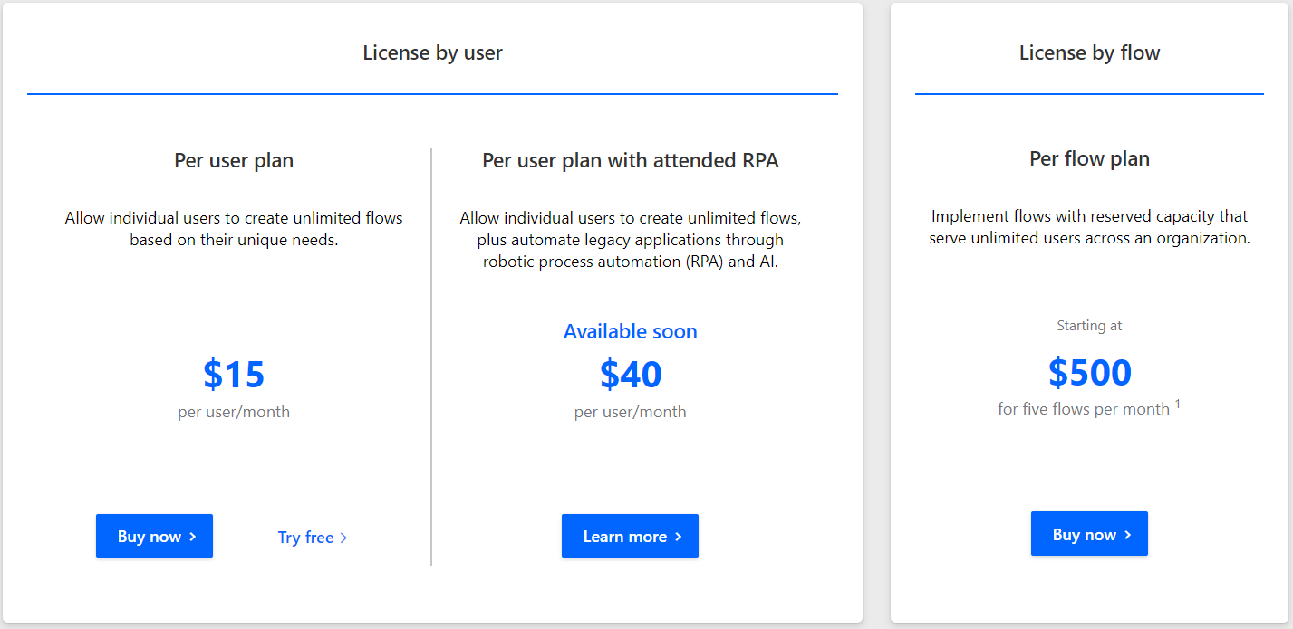
Microsoft Power Automate plan for you
https://flow.microsoft.com/en-us/pricing/

Slide 33
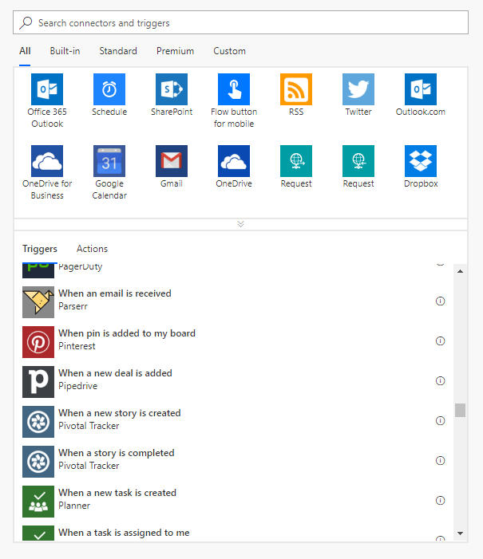
Types of Flows
Scheduled flows
Automated flows
Instant flows
Business process flows

Slide 34
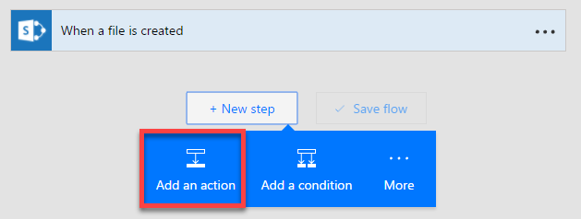
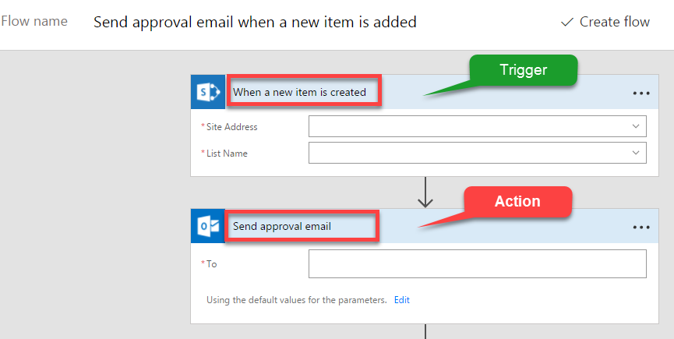
Flow Components
Three major components
Triggers
Actions
Conditions

Slide 35

Differences between Flows and Workflows

Slide 36
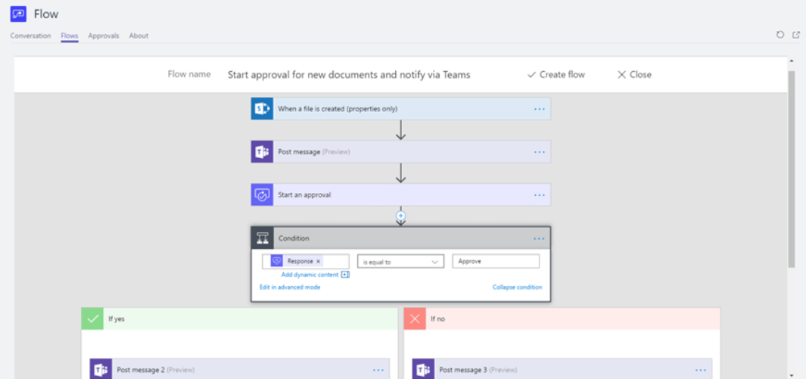
Benefits of automation

Slide 37
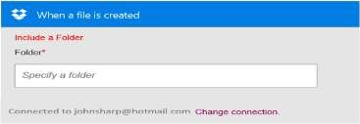
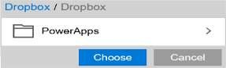
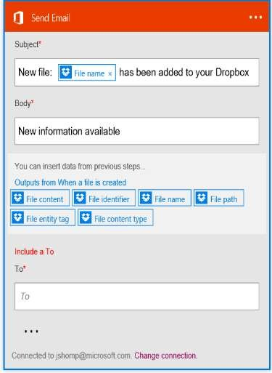
Build your own flows in an easy to use visual designer
Sending an Exchange email when a new file
is added in Dropbox
PowerApps
Authenticate to your Dropbox account.
Select folder to monitor
Choose to include properties from previous step (Dropbox file) to improve relevance
Authenticate to your O365 account.
Build email Subject and Body
Specify Send To email address and additional properties (optional): From, CC, BCC and Importance
Source: Microsoft
Connected to johnsharp@contoso.com

Slide 38
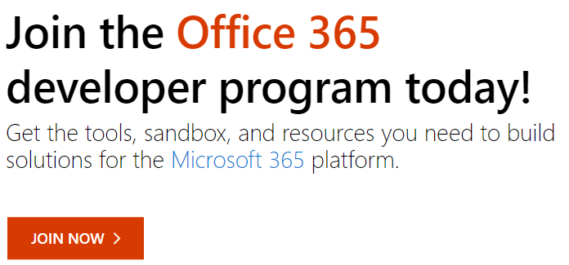
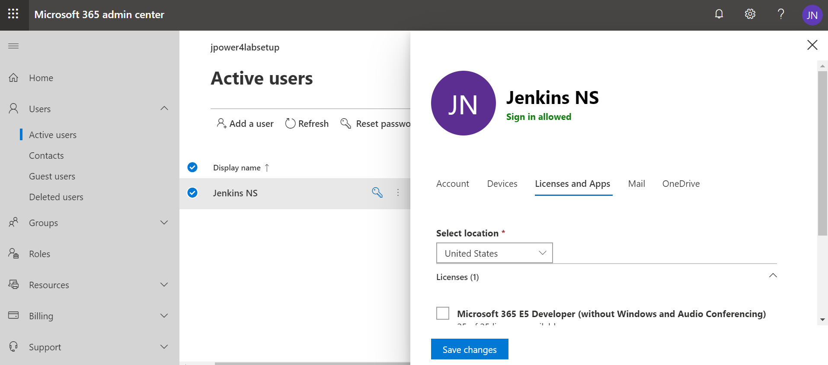
Setup Environment

Slide 39
Module 2
Microsoft Flow Templates
Flow Supported Data sources
Publish a template
Create flows from a Microsoft Teams template
Flows with many steps
Run tasks on a schedule
Watch a flow in action

Slide 40
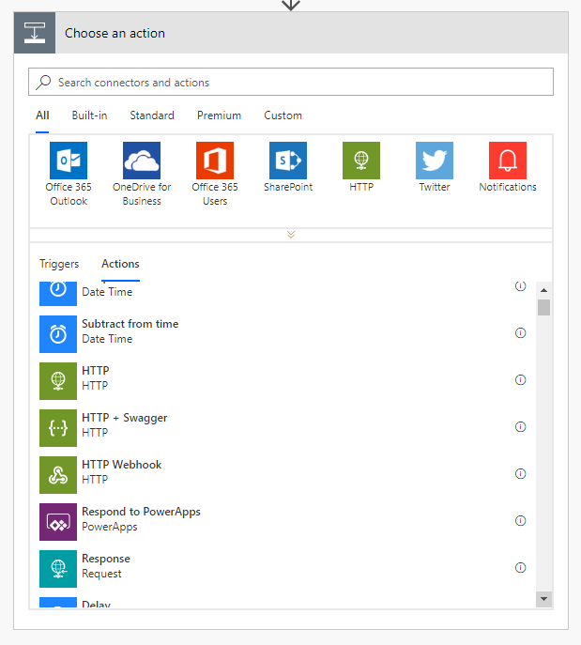
Actions in flows
1+ steps that run after the trigger
Connect to cloud service or on-prem via the on-prem data gateway
Directly connect to HTTP endpoints if there’s no out-of-box connector
Some actions may not even use connections – just manipulate data locally
Custom connectors connect to your own cloud or on-prem REST services

Slide 41
Flowing data
Trigger
Outputs:
File name
Size
File content
Data ‘flows’ from each step and is available for all later steps
Use Add Dynamic Content to select outputs from previous steps
Input types are matched to output types to show a subset of outputs by default
Expressions can be used to convert between data types or calculate derived values
Action 1
A binary field would see:
File name
Size
File content
Outputs:
Title
Count
Action 2
A string field would see:
A number field would only see:
File name
Size
File content
Count
Title
Size
Count

Slide 42
Demo & Hands-on

Slide 43
Module 3
Adding conditions
Designing switches
Using apply to each
Configuring do until logic
Adding a scope

Slide 44

Using expressions
Many reasons to use expressions:
Convert types
Perform simple, inline calculations like string manipulation or arithmetic, or date/time manipulation
Generate data like the current time, a GUID or a random number
Handling optional values
“If” conditional statements / control flow
Working with lists
?

Slide 45
How to create expressions
1
Add Dynamic Content
Dynamic content
Dynamic content
Expression
2
Expression
fx
replace(body('Get_record')?
OK
Action name
3
Inputs
fx
replace(…)

Slide 46
Anatomy of an expression
fx
replace('Title: placeholder', 'placeholder', 'Flow')
Expression name: replace
One or more parameters, separated by commas
Use single quotes around static text
Include expressions in other expressions

Slide 47
Other expressions
body(stepName)
Returns an object with all properties of a different action
triggerBody()
Like body() but for trigger output.
item()
Used to reference the current item in Apply to each
Also used for actions that take an array and manipulate them
variables(variableName)
Reference a variable

Slide 48
Data types and formats
Strings – aka text
Normal – 'Example string'
Email, URL, phone number, etc…
Base64
Binary content
Data URI
URI component
For strings use single quotes
Non-text
Floating-point number – 9.0
Integer number – 137
Boolean – true or false
Array – a list of items
Object – a record with key-value pairs
Do not use single quotes for numbers, integers or Booleans:
'true' does not equal true
[ ]
{ }

Slide 49
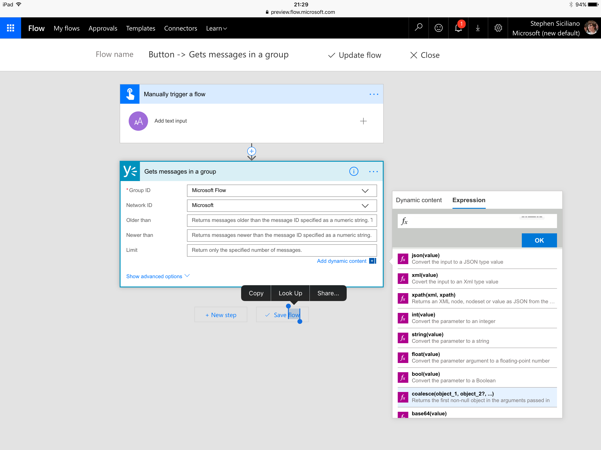
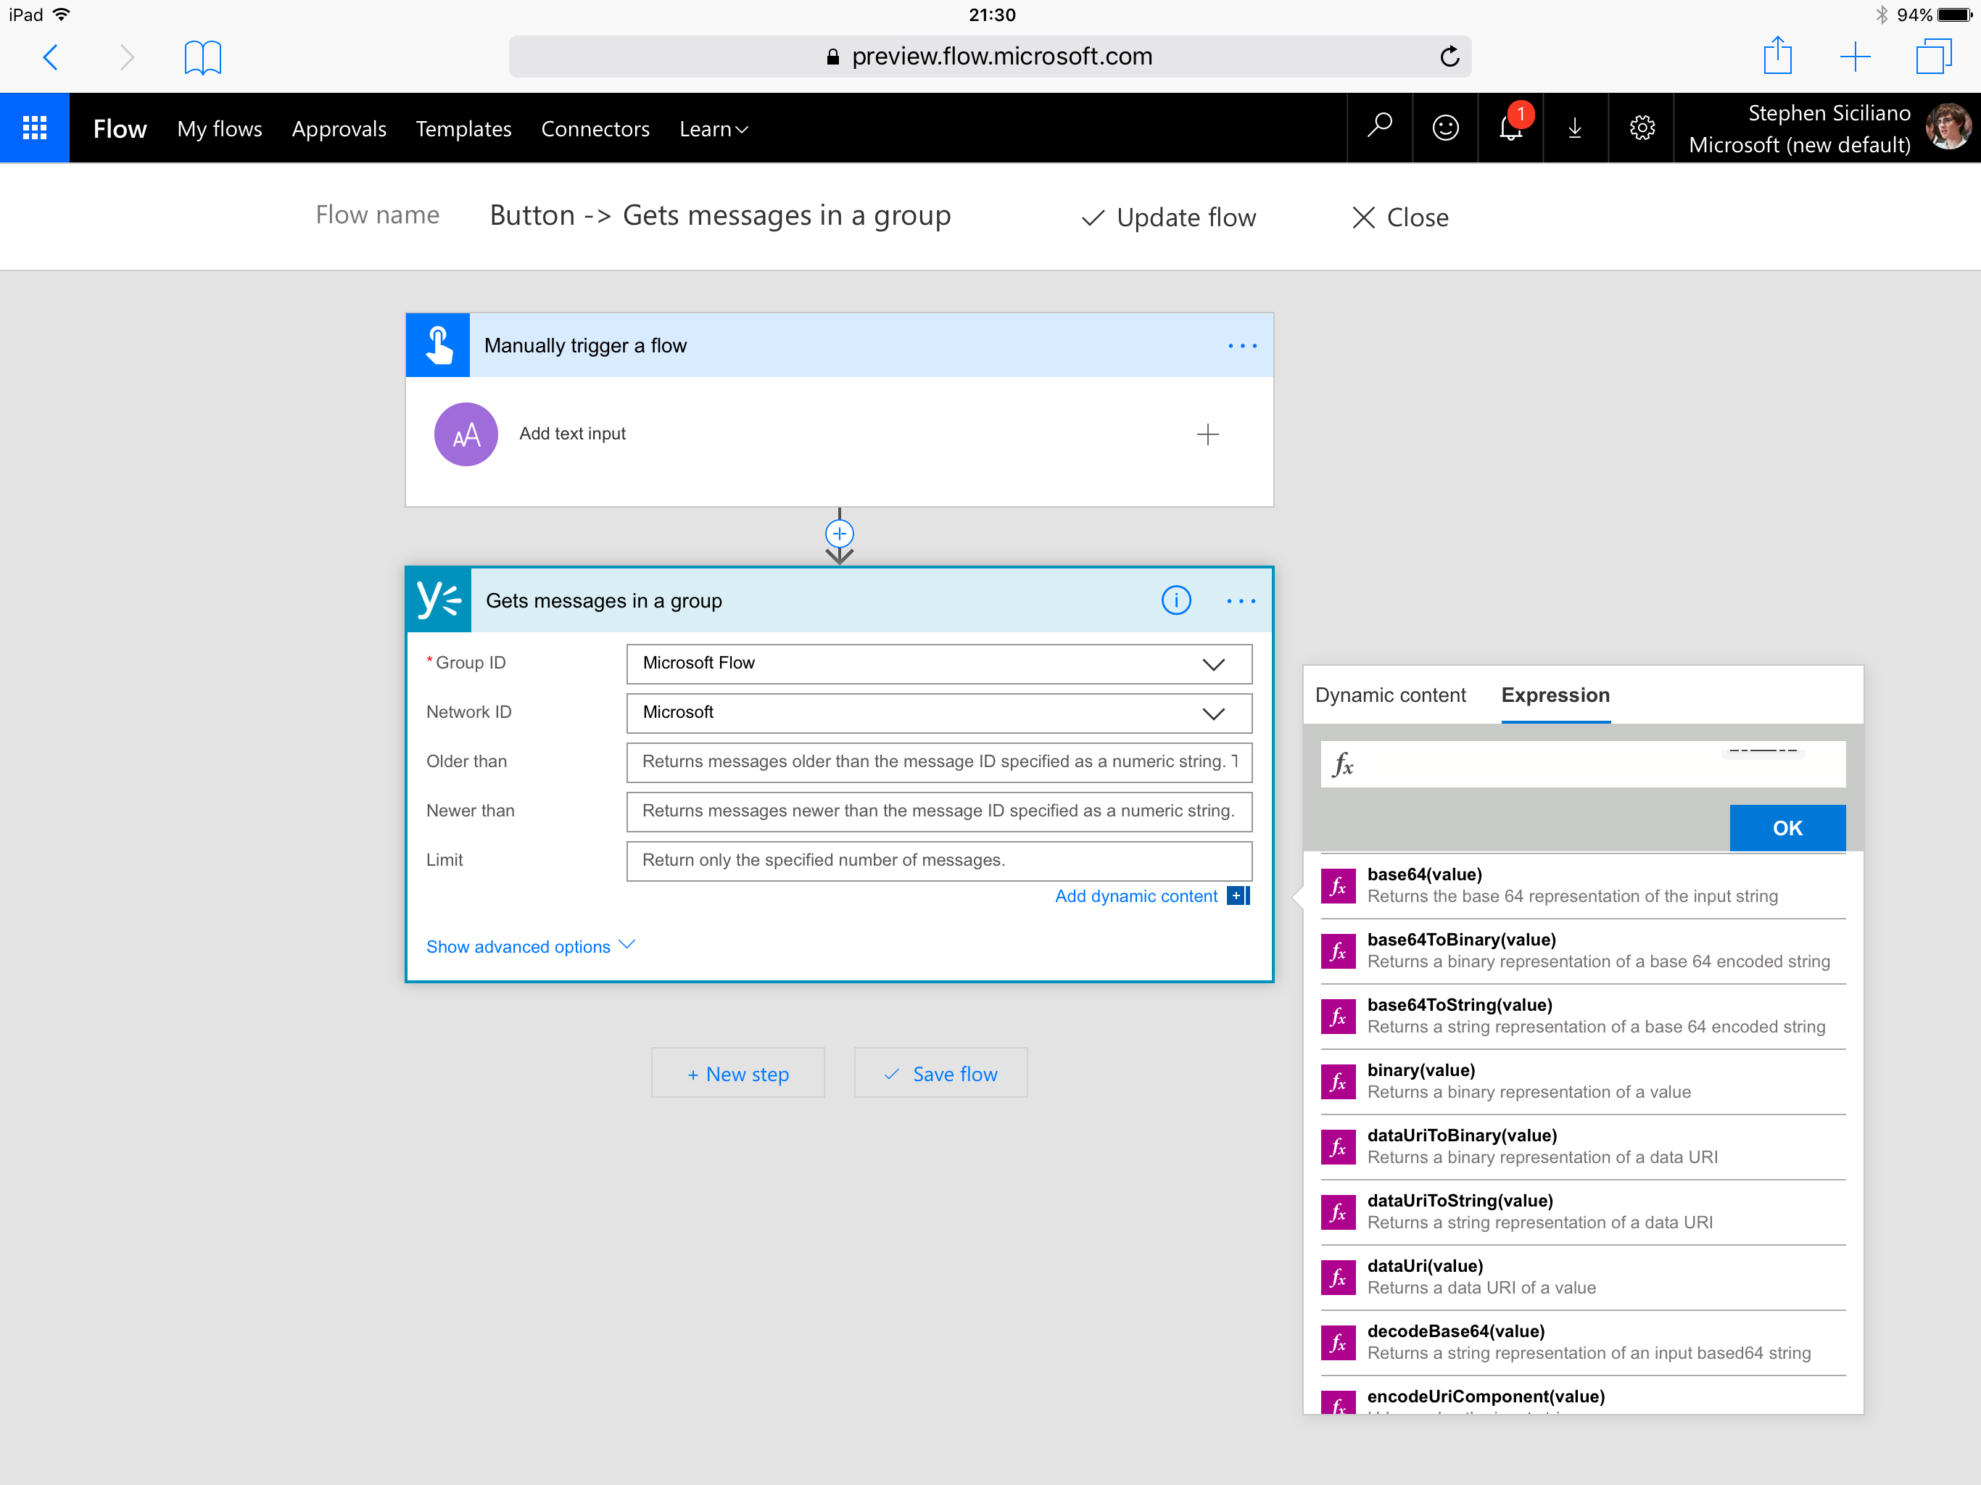
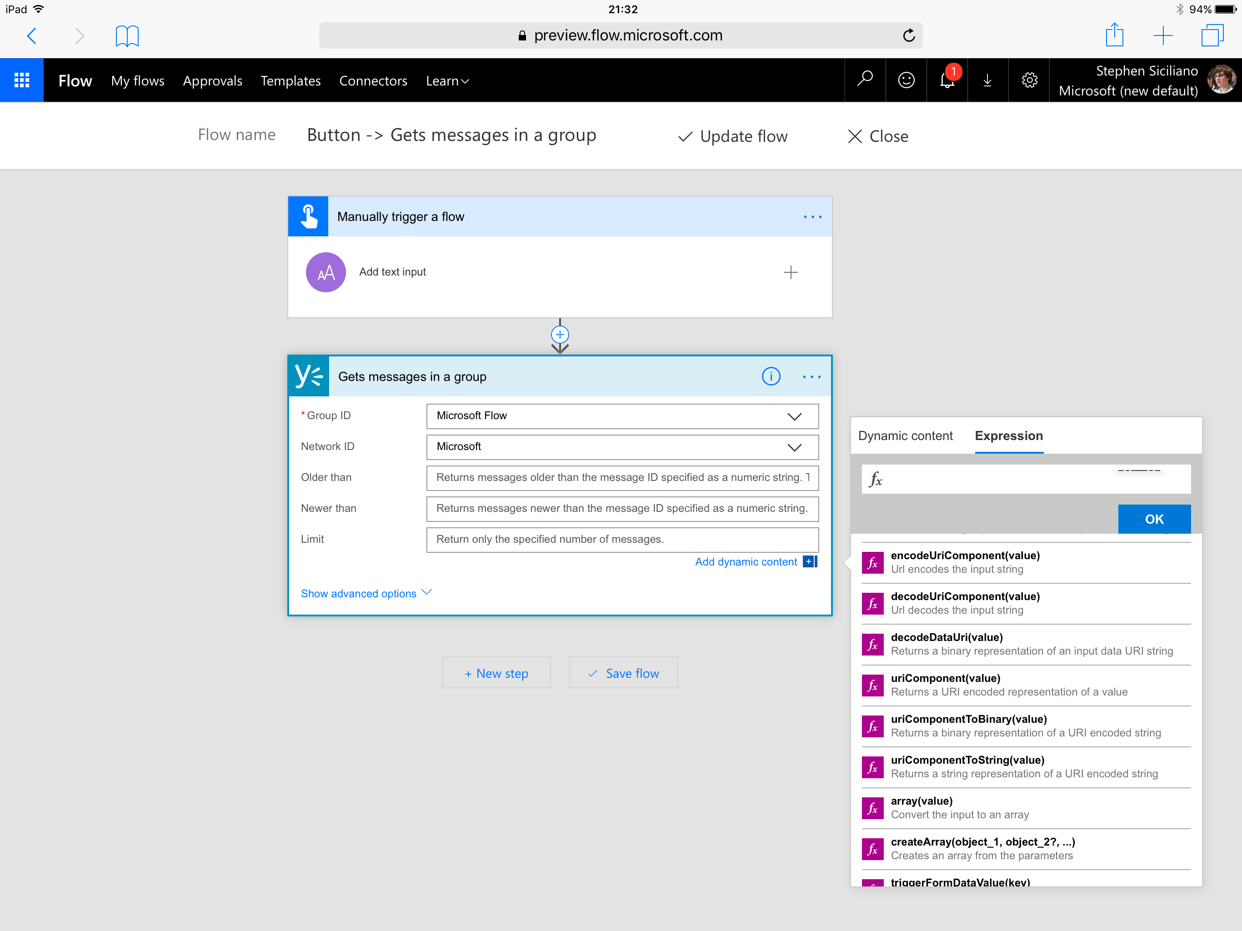
Handling content conversion
Some conversion is automatic (i.e. integer input into string field)
In some cases, a conversion expression is automatically added by the UI
Other conversions you’ll need to author an expression for directly
The expression is named for the destination type
For example to convert to base 64, use the base64() expression

Slide 50
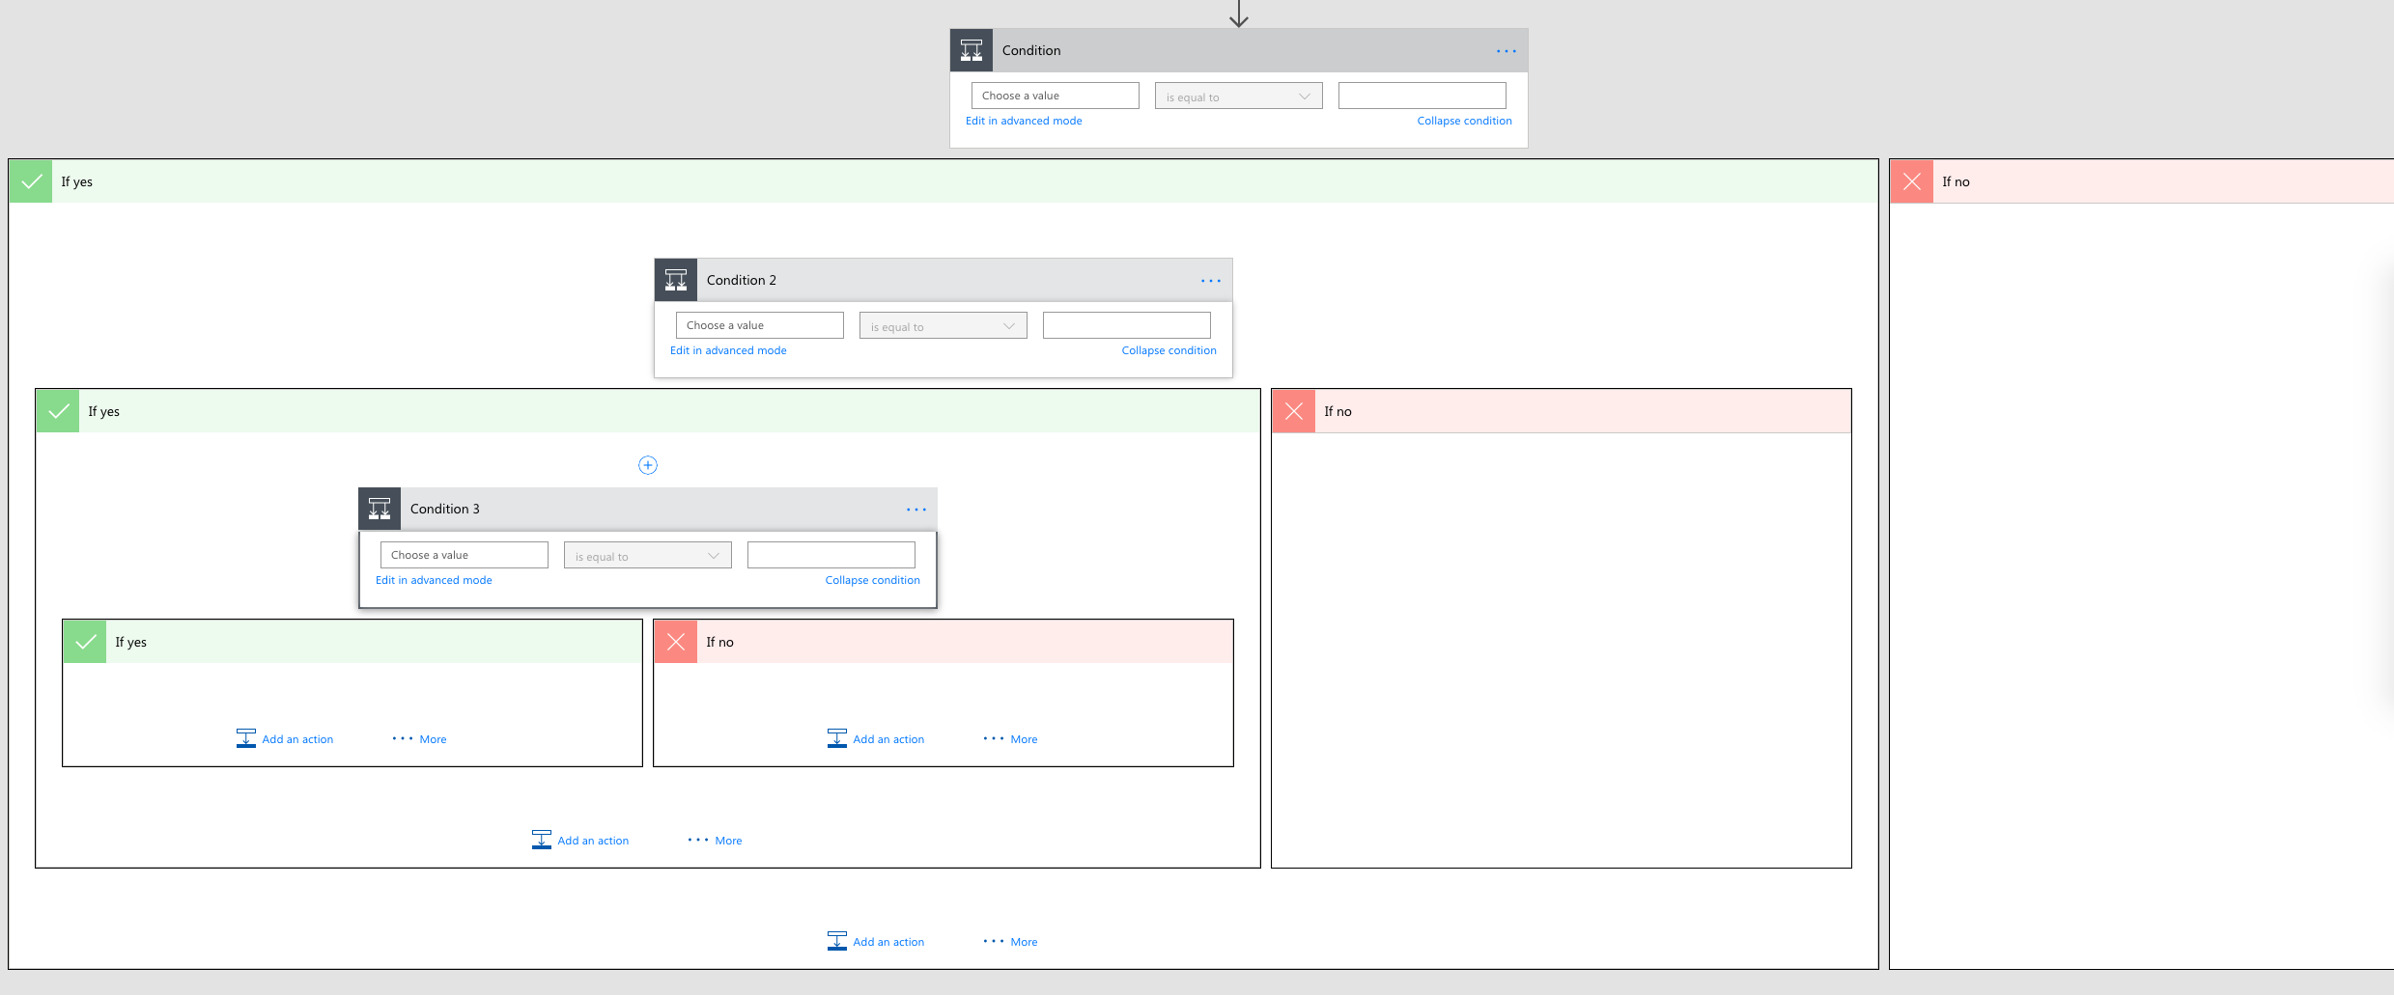
The if() expression
Why use the if() expression if you can use a condition?
Avoid multiple nested conditions just to set a field
Caution: The if does not ‘short circuit’ which can result in errors if you try to reference a missing property in one branch

Slide 51
Handling optional values
Caution: trying to use a property that’s not set – aka “null” -- will cause the flow to fail
Two steps to handle:
Use the “?” character after selecting the property (this happens automatically). Use when chaining access to sub properties.
Then, use the coalesce() function to provide a default value
coalesce(body('Get_record')?['parent']?['child'],'Default Value')

Slide 52
Working with Arrays

Slide 53
What are Arrays?
A few different classes of things you may need:
Repeat an action over each list item
Get a single item from a list
Filter a list down
Make a list work with a different action
Jane
8.29
ID: 123
Name: Jane
Mail: J@a.c
Dan
4.89
ID: 888
Name: Bob
Mail: B@a.c
Steve
0.28
ID: 456
Name: Dave
Mail: D@a.c

Slide 54
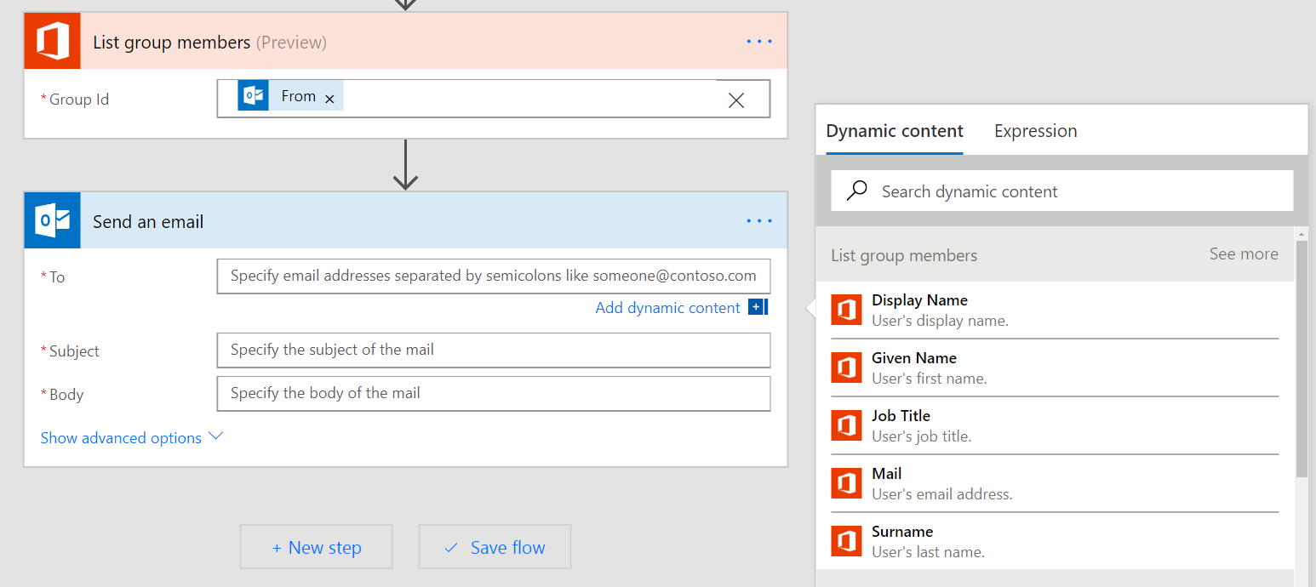
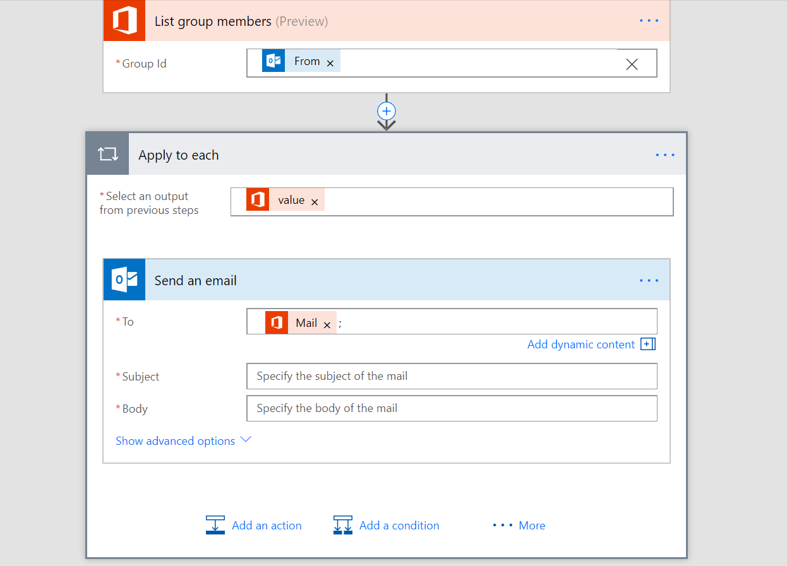
Apply to each
Automatically added when you try to use an output that’s part of a list
Destination step to repeats over every list item
If you do NOT want this you can:
Get only one list item using an expression, or,
Convert the whole list to a string in the form of a list or a table

Slide 55

Getting certain list items
0
Use the first() expression to get the first item from a list
Use square brackets and a number (starts at 0) to get a certain item, for example [2]
Use the last() expression to get the final item
1
2
3
Note: If the array is a list of Strings, Numbers, Booleans etc…, then the above expression can be used directly. However, if it is an array of objects, you will need to use square brackets to select the specific property you need:
last(body('Get_rows')['value'])['mycolumn1']
body('Get_rows')['value'][2]['mycolumn1']

Slide 56
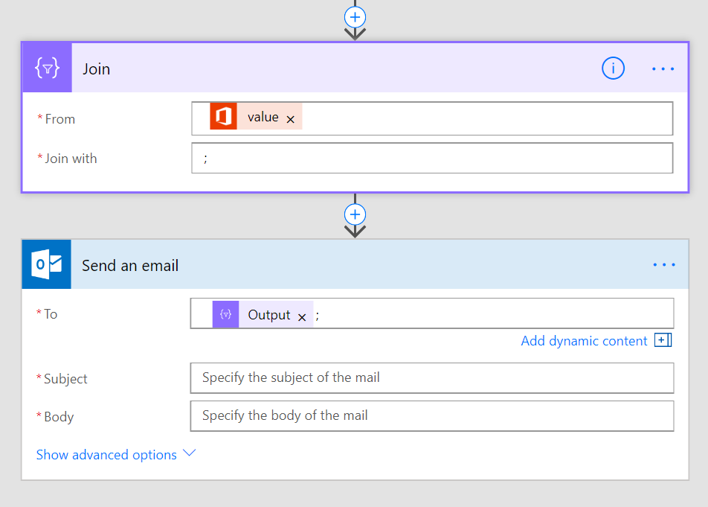
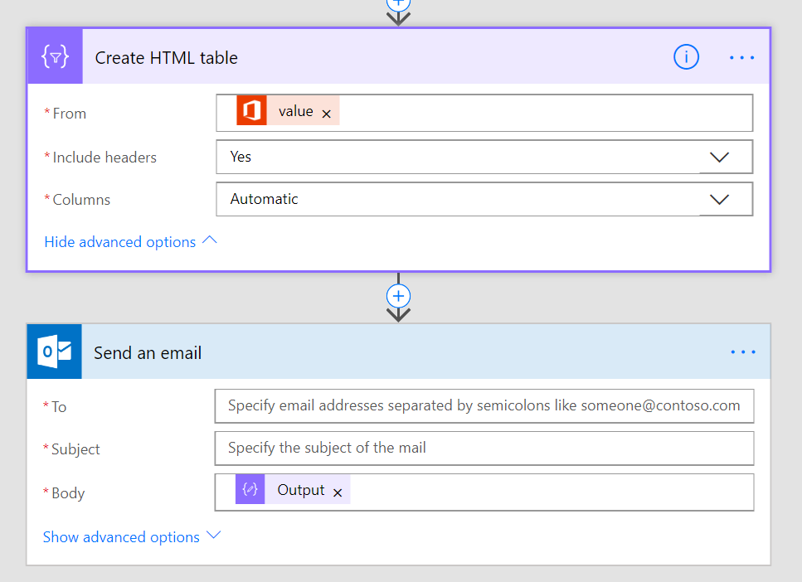
Convert the list to a string
Join – use join to get a simple list, for example, if you have a list of email addresses*
Create HTML/CSV Table – convert a list of Objects to a tabular display format, for example, for inclusion in the body
* Note: You must have a list of strings, not a list of Objects. Use Select if you want a sub-property of each object.

Slide 57
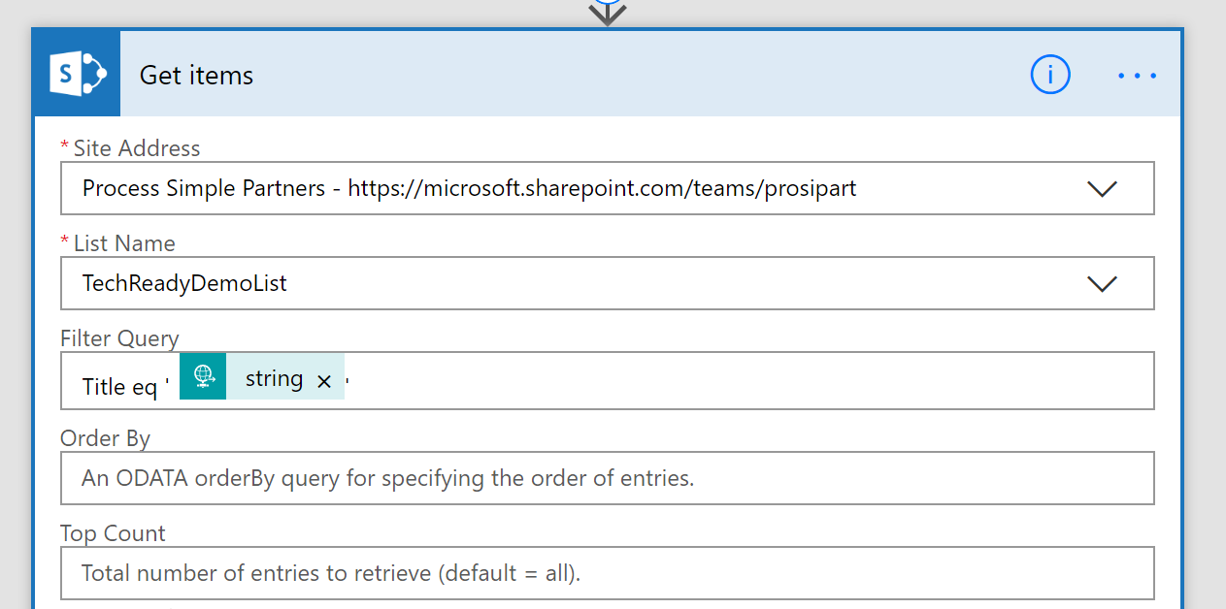
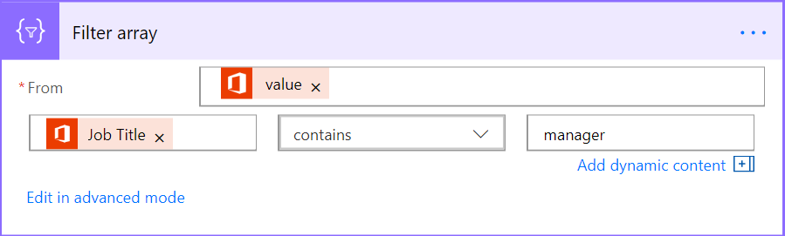
Filtering
Ideally – have the connector do the filtering for you
Requires use of OData syntax and is limited. Read more here.
Built-in Flow action – Filter array
Select the Array in the From field
Can either use simple or advanced mode just like for Conditions
If you need the first N items you can use take() or skip()

Slide 58


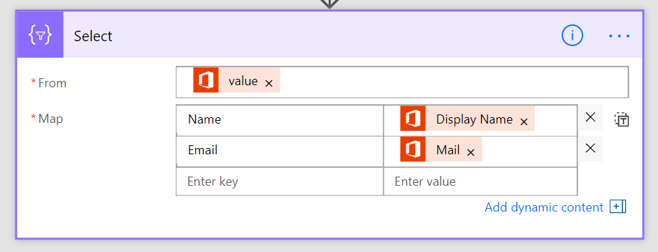
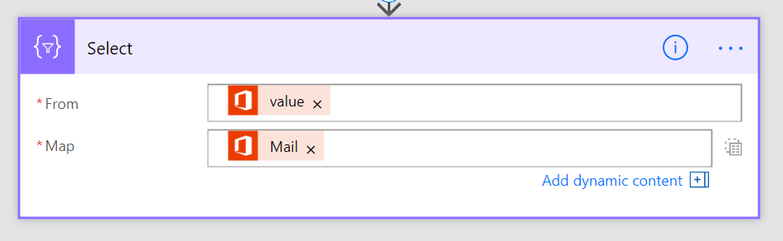
Transforming Arrays
Two input modes: fill key-value pairs, or typing expressions directly in
Create an array of objects
Create an array strings, numbers, booleans, etc…
Useful for passing this Array to another action
Useful for getting a simple list, for example, of email addresses

Slide 59
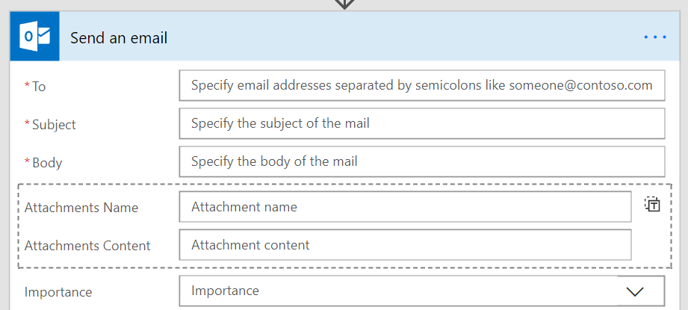
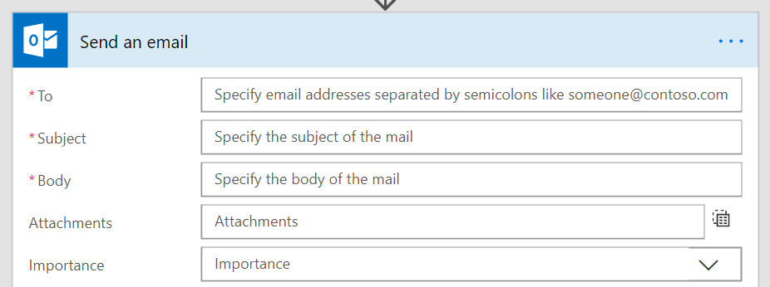
Passing data into arrays
Can hardcode a list – or – have the list be dynamic at runtime
Fill in each property of the object and get one item created
Need to pass in an Array that exactly matches the fields

Slide 60

Checking list containment or duplicates
You can use the contains() expression to see if something is in an array
Use the union() function with the array twice to get a set of unique items

Slide 61
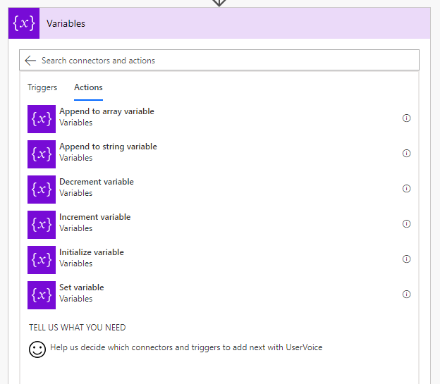
Variables
Define the type and initialize the variable before you use it.
Useful for:
Counters – you can increment or decrement variables
Append to arrays or strings
Set state, check it elsewhere in the flow
Simplify expressions – no need to keep checking object?[‘p1’]?[‘p2’]?[‘p3’]

Slide 62
Escaping rules
When you directly are using the expression language you may need to escape certain characters
Using strings with a single quote character:
@substring('It''s A Great Day!',1,5)
Using spaces in action names:
@body('Name_with_spaces')
Building an object you need to escape ‘@’:
{
"@@Odata.type" : ""
}

Slide 63
Module 4
Introducing Microsoft Flow
Create your first flow
Learn to use the Microsoft Flow mobile app
Receive text and email notifications from flows
Copy files with flows
Create recurring flows
Post tweets with Microsoft Flow
Create team flows
Troubleshoot flows

Slide 64
Control flow and action settings

Slide 65
Normal action execution
Run in sequence
Flow terminates once an error (failure or timeout) is encountered
Skipped means the previous action didn’t run
Summary: four possible states for an action:
Succeeded
Failed
Timed out
Skipped

Slide 66
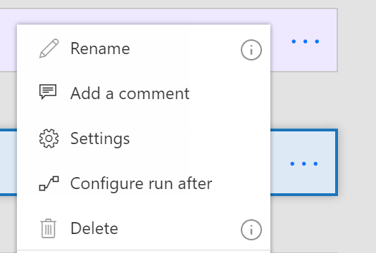
Action settings
The “…” menu contains entry points to Settings and Configure run after
Settings lets you configure:
Async Actions
Timeout
Retry policy
Sequential
And more!

Slide 67
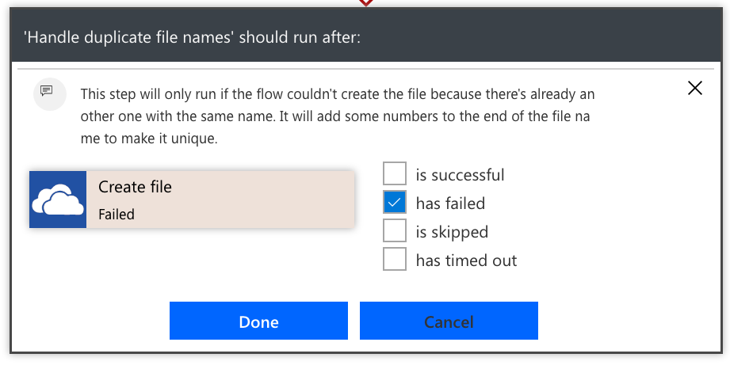
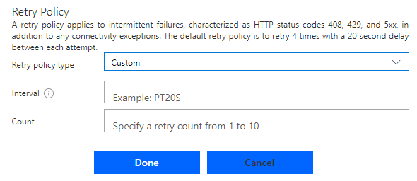
Error handling
Select the Run After option in the action menu
Choose which error conditions, the arrow will turn dotted red
Use parallels for errors that aren’t at the end of the flow
Retry policy by default handles transient failures
Recommended to choose exponential policies as they can go for a long period of time

Slide 68
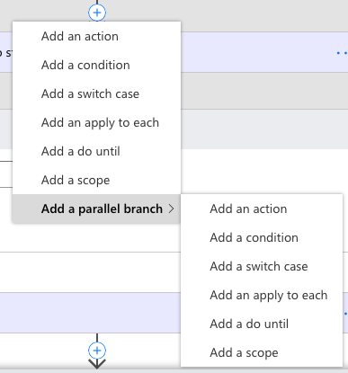
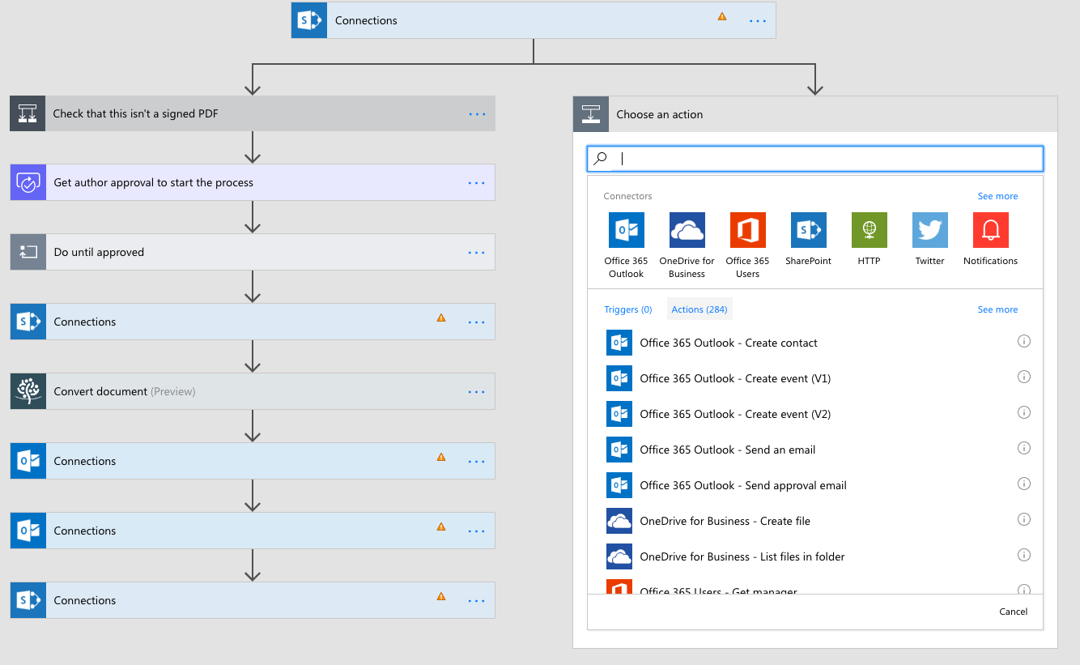
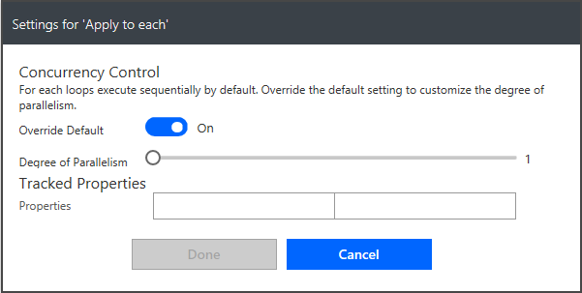
Parallel execution
For actions select Add parallel branch from the above the action
Inside of an Apply to each you can control parallelism

Slide 69
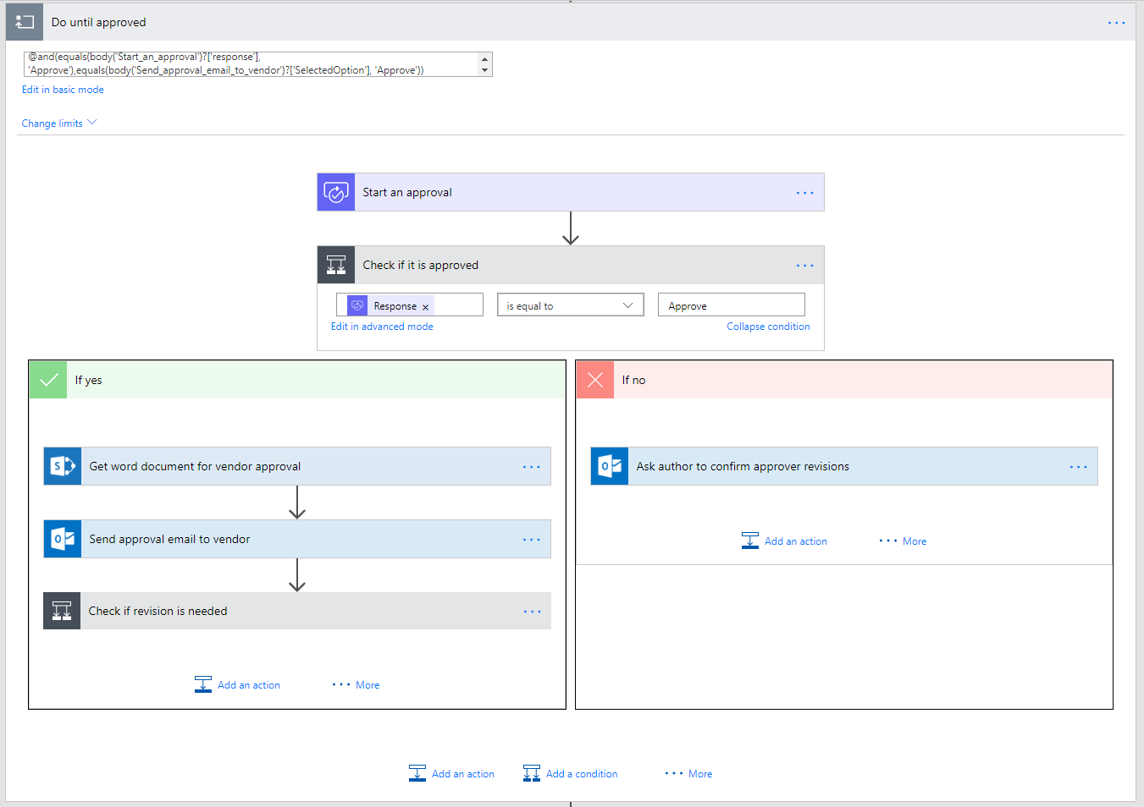
Looping
Stage 1 approval request
Stage 1 Approved?
Do until - actions that you want to repeat until a condition is met
Do something until condition
i.e. Do until an approval is completed
Caution: Executes at least once
Stage 2 approval request
Ask Author to make changes requested by Stg.1
Stage 2 Approved?
Ask Author to make changes requested by Stg.1
Revisions completed?
Mark document as approved

Slide 70
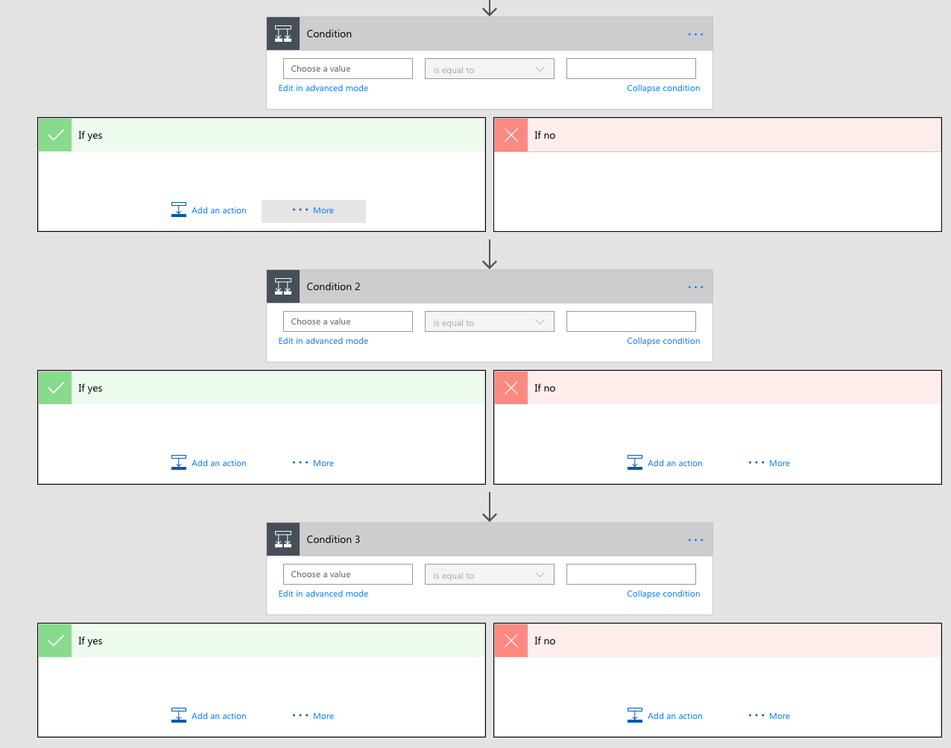
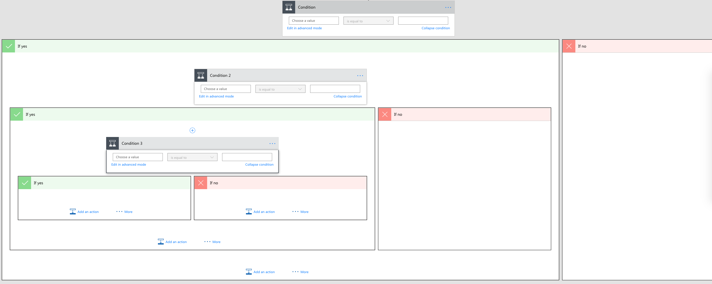
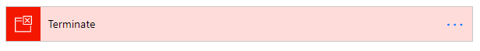
Terminate flows
You can use this action to avoid nested conditions by ending in the middle

Slide 71
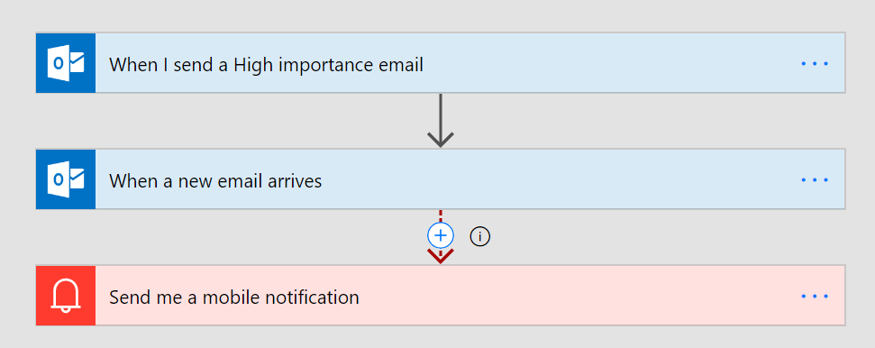
Asynchronous Actions
Any “trigger” can be in the middle of a Flow as well
For example, create a flow that waits for a reply to a certain thread in the middle
You probably want to configure a Time Out and handle that case
Do-Until might also be needed if other unrelated events may trigger

Slide 72
Module 5
Standard and premium connectors
Connecting to web services
Using Flow with on-premises data

Slide 73
Connectors

Slide 74
Why build a connector?
Enterprise developers
Looking for connectivity to a service we don’t currently support
Need connectivity to a custom or internal service
Partners and ISVs
Expand the number of services you integrate with
Provide the extensibility your customers need
Increase exposure and adoption

Slide 75
Building a Custom Connector



Develop
Build, secure and describe your API
Import from existing artifacts (Open API, Postman) or build from scratch
Test
Validate your API calls
Use in Flow and PowerApps for E2E testing
Share
Allow other users within your organization to use your connector

Slide 76
Building a Custom Connector




Develop
Build, secure and describe your API
Import from existing artifacts (Open API, Postman) or build from scratch
Test
Validate your API calls
Use in Flow and PowerApps for E2E testing
Share
Allow other users within your organization to use your connector
Certify
Share your connector with all users of Flow and PowerApps
Only for Public Connectors

Slide 77
Custom connector architecture
Hosting environment
Connector ID
+
Operation
+
Connection ID
Host
+
Path
+
Credentials
RESTful API
Microsoft Flow
Custom connector
PowerApps

Slide 78
Using your own Web API
Hosting environment
Your
Web API
Microsoft Flow
Custom Connector
PowerApps

Slide 79
Securing your Web API
Hosting environment
AAD Application #1
AAD Application #2
Your
Web API
Microsoft Flow
Custom Connector
PowerApps

Slide 80
Connectors Demo

Slide 81







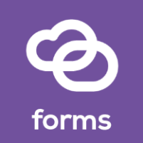




Custom Connector Resources
https://docs.microsoft.com/connectors
Custom connectors
From Postman Collection
Webhooks
Dynamic values/schema
https://aka.ms/apiconnectors
Submit for certification
Example Video : https://youtu.be/dBCS1nPsDiE
Notes:
https://www.googleapis.com/books/v1/volumes?q=search
https://www.googleapis.com/books/v1/volumes?q=ISBN:9780789748591
Gallery
First(mybooks).items
ThisItem.volumeInfo.imageLinks.thumbnail
ThisItem.volumeInfo.title
ThisItem.volumeInfo.description
Host : www.googleapis.com
Base Url: /books/

Slide 82
Demo & Hands-on
Connect REST API using connector
Notes:
https://docs.microsoft.com/en-us/powerapps/maker/model-driven-apps/embedded-canvas-app-add-classic-designer
https://www.sharepointpals.com/post/step-by-step-procedure-to-call-sharepoint-office-365-rest-api-from-microsoft-flow/

Slide 83
Module 6
Learn to build more complex flows
Build an approval request
Build a flow that processes an approval request
Create a flow that stores documents
Build a flow that uses information like locations or date
Build a flow accepts user input when run
Learn to build a flow that runs at recurring time intervals
Build a flow that runs when an event in Dynamics 365 occurs
Build a flow that uses SQL
Integrate PowerApps, Flow, and SharePoint
Create a business process flow
Create a business process flow that has conditions
Monitor flows
Sharing Flows

Slide 84
Module 7
Administer flows
Export and import flows
Learn how to distribute button flows
Maintaining a Flow
View history and analytics
Sharing a Flow
Export and import Flows
Office 365 administration for Flow
Environments
Data policies
Data integration

Slide 85
Best Practices

Slide 86
Best Practices for Flow Authoring
Rename action cards
Add comments
Don't touch production, work on a copy!
Prototype with button triggers
Iterate – build your flow one piece at a time
Use variables/compose to simplify checks & conditions
Keep it simple

Slide 87


Flow duration :
30 days
Controller pattern
Flow Approval
duration : 30 days
250 actions/flow
Create nested flows or raise a ticket
Loops
Max 5,000 iterations in Do until –> Create embedded loops
Max 5,000 iterations in For each (100,000 in Plan 1)
No custom task forms
Custom approval actions
No guest access
In the roadmap for Flow & PowerApps
No State Machine
State machine pattern or Controller pattern
ALM/devops weak
I could tell you, but then I would have to kill you…
Cannot resume flow
In the roadmap

Slide 88
PowerApps Data Submit using Flow

Slide 89
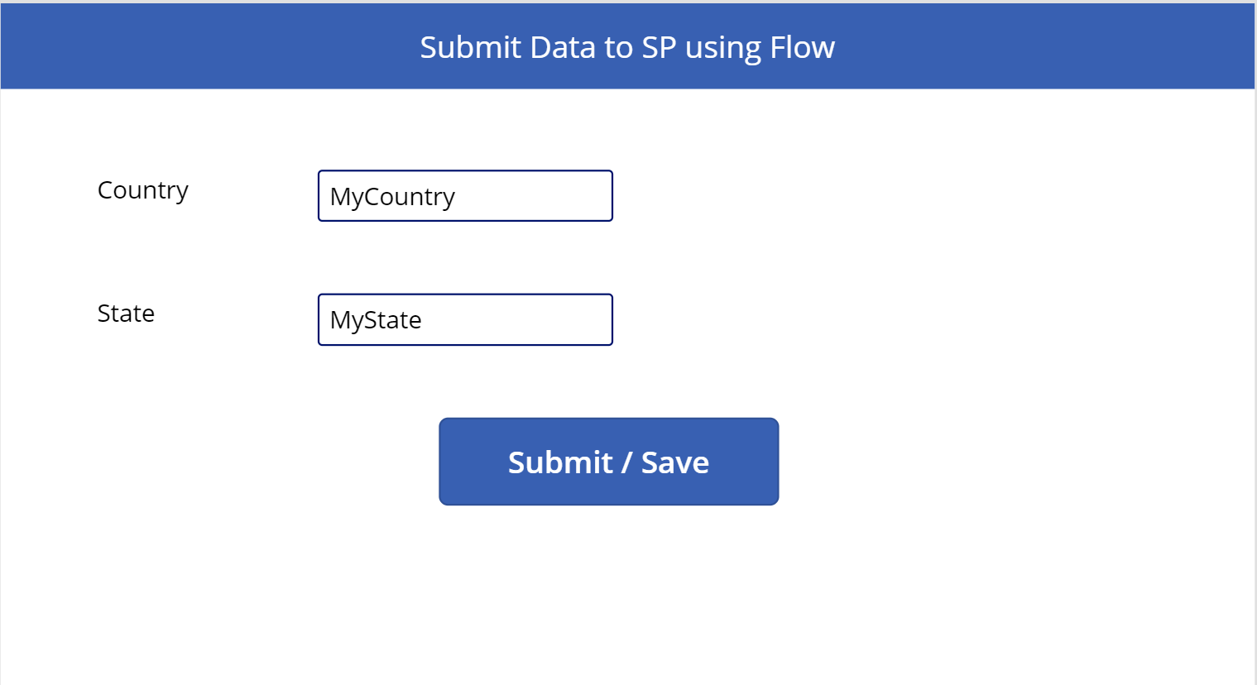



Demo & Hands-on – Save data Power Apps form data using Flow
Notes:
PowerAppWF.Run(txtcountry.Text,txtState.Text)

Slide 90
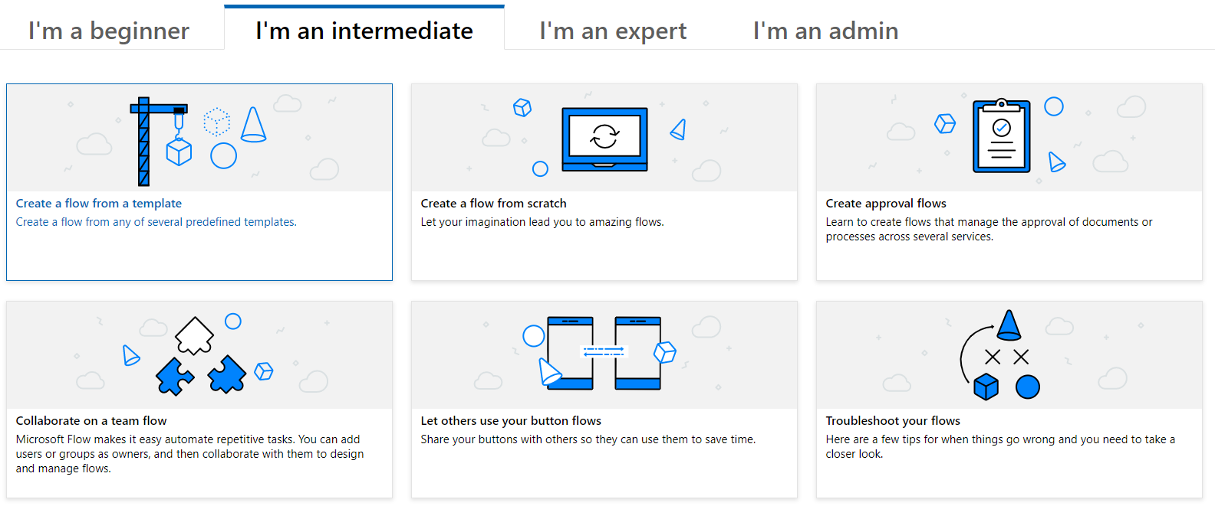
Microsoft Flow Documentation
Notes:
https://docs.microsoft.com/en-us/flow/

Slide 91
Q & A

Slide 92
References
https://flow.microsoft.com/en-us/blog/author/jolevesq/
https://www.youtube.com/channel/UClBCcDTylJUzvP8sycg6pEA

